Slide 1

School Registration SysteM presentation
Jason Simms
University of Arizona Global Campus
CST499: Capstone for Computer Software Technology
Notes:
Welcome to the Student Registration System presentation. My name is Jason Simms and I will be walking you through the creation and layout of the student portal for Lothlorien University.

Slide 2

AGENDA
PROJECT INTRODUCTION
WEBSITE LAYOUT AND WALKTHROUGH
REGISTRATION PAGE
LOGIN FUNCTIONALITY
LOGOUT FUNCTIONALITY
ADD/DROP CLASS FUNCTIONALITY
MYSQL DATABASE
Notes:
Our agenda for this presentation is to begin with an introduction of the project and technology utilized. We will then dive into a quick walkthrough of the website and show a high-level view of the layout. Next up we’ll dig a bit deeper into the database and look at each page and its functionality.

Slide 3

INTRODUCTION and layout
Student Portal Project
Lothlorien project to create a student portal.
Project build will utilize HTML, CSS, JavaScript, and MySQL
Website to include 6 pages:
Home
Registration
Login
Profile
Current Courses
Catalog
Notes:
Lothlorien University is a growing university with over 2,000 faculty members and 16,000 students. Their President Lana Galadriel has asked the team to create a student portal for the university. This will allow students to register, view their profile information, search the course catalog, register and drop courses, and review waitlist information for classes that are full. The student portal will be linked to a database, which also gives Lothlorien University the ability to view, store, and report out on student and course information.
To begin this project, it is important to understand the technology behind it. Front-end web development includes the use of Hypertext Markup Language (HTML), Cascading Stylesheet (CSS), and JavaScript. HTML is the structure or foundation of the web page. CSS adds style and visual appeal to the web page. JavaScript adds functionality and interaction to the webpage. In general, these three tools are used to create the dynamic and functional websites that users interact with on a daily basis, and these are the tools that will be used for the student portal project. In addition, the team will be using a MySQL database to hold all the student, course, and staff information, such as name, address, phone, course name, semester, and year.
In its initial build the website will contain 6 pages.
The home page which includes information about the university and acts as a landing page for the website.
The registration page which allows students to register for access to the student portal.
The login page which allows students to login into the student portal.
The profile page which allows a logged in student to view their information and the course catalog.
The current courses page which provides students with a current list of their enrolled and waitlisted courses.
The catalog page which provides students with information on available courses and the ability to enroll in them.
Let’s take a deeper look at each of these pages and their functionality.

Slide 4
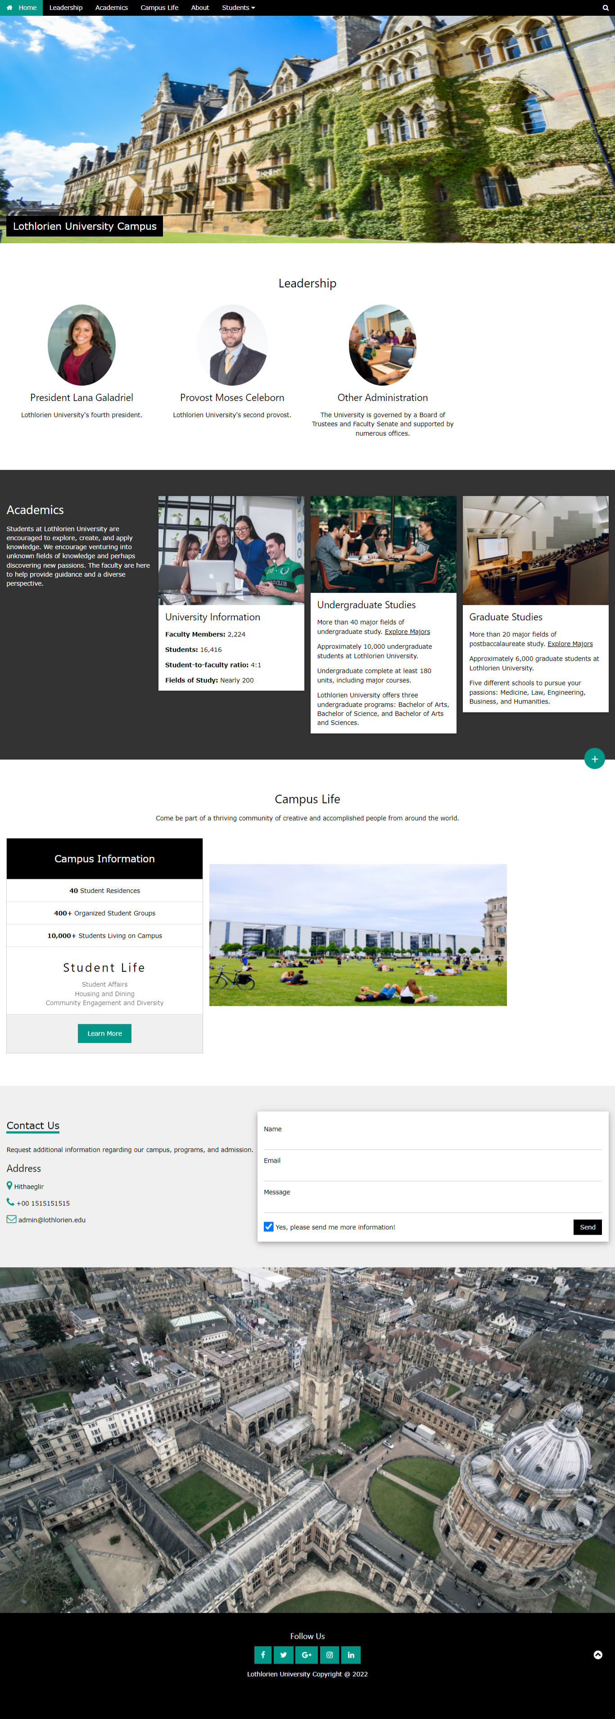
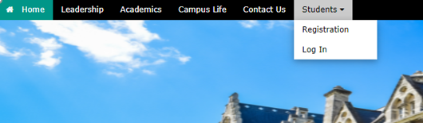
Home page
Landing page for all users to website
Provides access to registration and login page for students
Notes:
The home page is the initial landing page for the website. It provides information about the university as well as access to other areas on the website, including the registration form and login page. You’ll see on the top menu bar that students have the ability to hover over the drop down and either register for access to the portal or login.

Slide 5
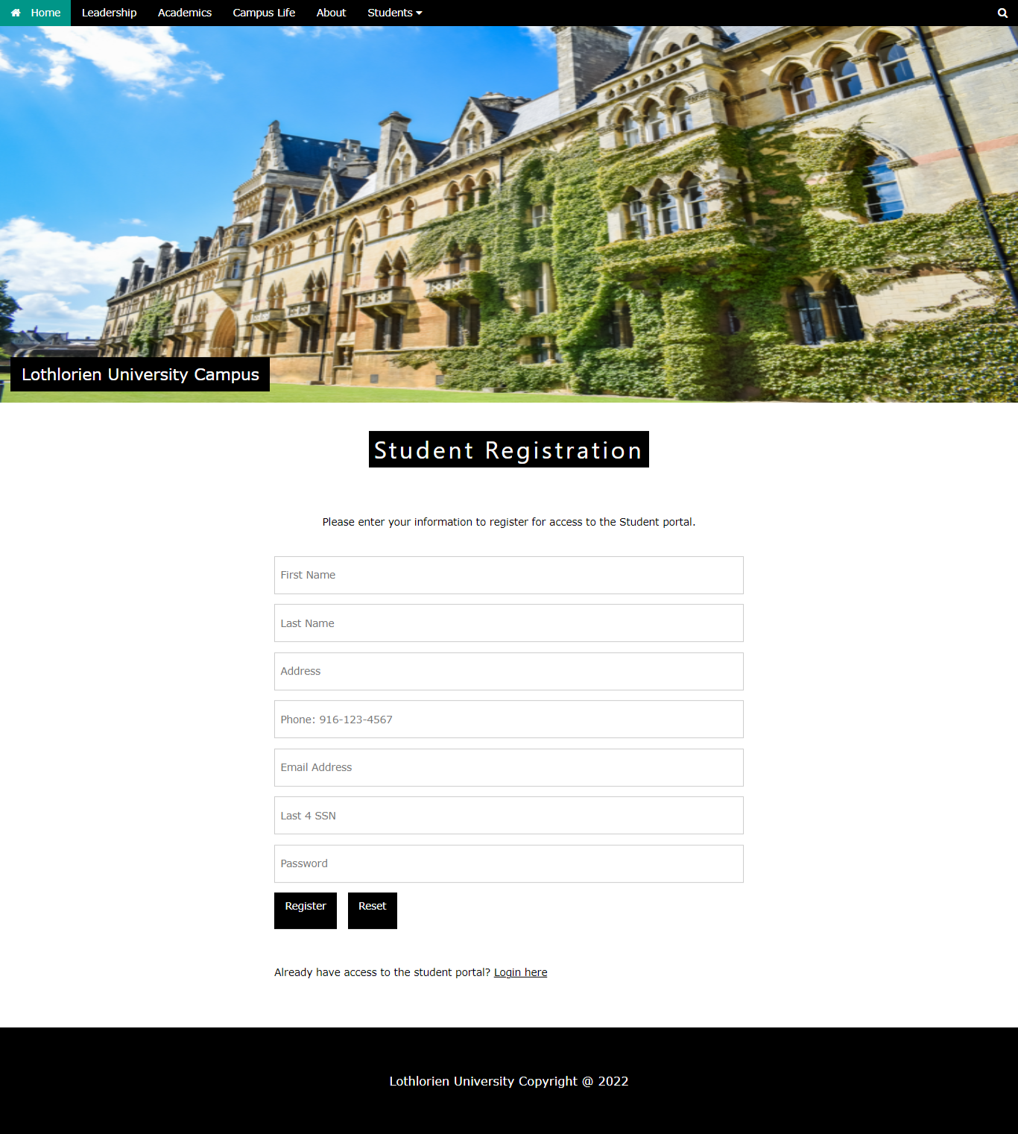
Registration page
HTML form for students to register for student portal access
PHP code:
Connects to MySQL database
Collects student information from the form and assigns it to variables
Creates SQL statement to insert data into database
Notes:
The registration page provides students with the ability to enter their information and gain access to the student portal. This collection of data is entered into a HTML form. Once the user clicks the register button the php code collects all the entered information and assigns them to variables. A SQL statement then takes the information in those variables and enters them into the appropriate columns of the database. Let’s switch over to the registration page now and take a deeper look.

Slide 6
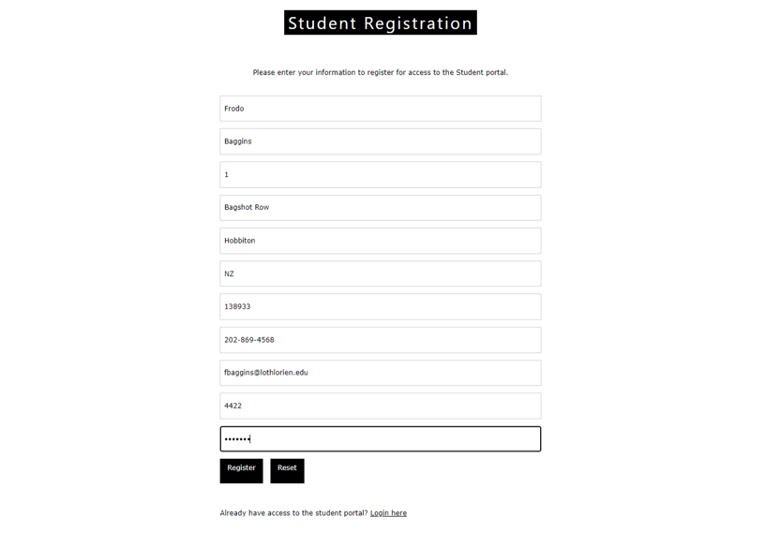
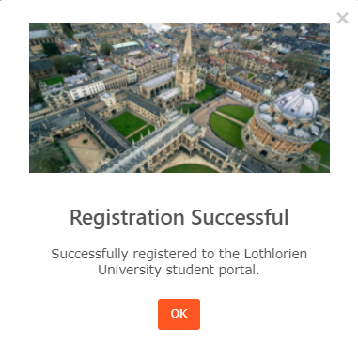
Registration example
Notes:
Let’s use student Frodo Baggins as an example. Here we can see he has entered all his information into the registration form and is ready to finish. Once he hits the register button, he receives a registration successful message. If Mr. Frodo were already a registered user he would receive a message that he already has an account and would be prompted to log in. You may notice that at the bottom of the registration form there is a link for students to log in if they have already registered. Now let’s see what’s happening behind the scenes when a student successfully registers.

Slide 7
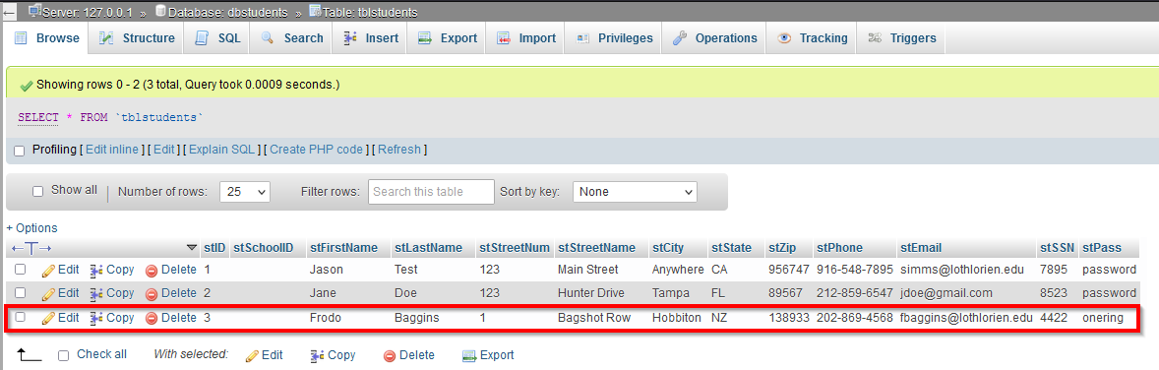
User Database
Notes:
Once Mr. Frodo hits that registration button all the information he provided gets assigned to variables. These are then used in a SQL statement to insert the information in the user table. Here we can see that Mr. Frodo has been added to the students table and all of the information that he provided has been captured in the appropriate column.

Slide 8
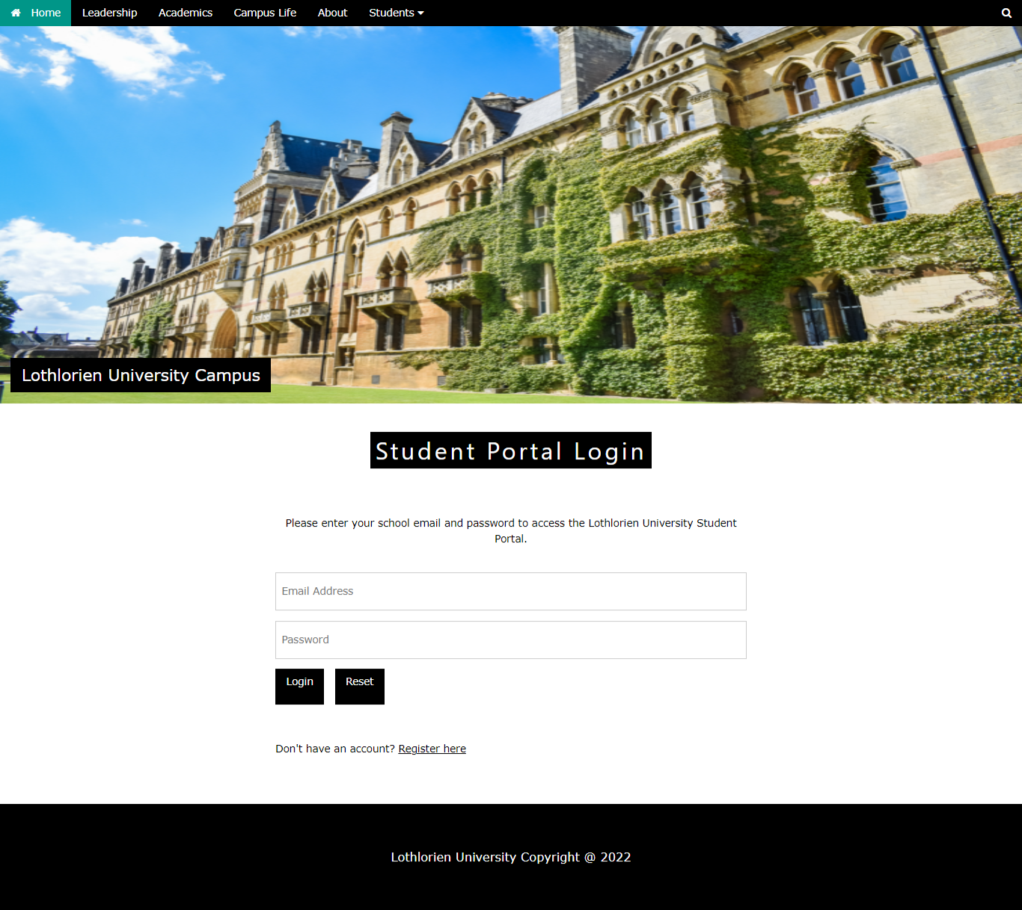
Login page
HTML form to collect user’s email address and password
PHP code:
Connects to MySQL database
Collects login information and assigns it to variables
Creates a session
Creates SQL statement to count instances where username and password entered equal values in database
Pulls row where match in database was found
Notes:
The login page allows the student to access the student portal after they have registered. If the employee does navigate to this page but has not yet registered for access, there is a quick link at the bottom of the form that will redirect them to the registration page. There are only two fields, the email address and password, in this HTML form. Once the student enters their information and clicks login the php code collects that information and assigns it to variables. It then searches the user database to find a match on both the email and password. If a match is found the login session is created and the student is redirected to the login landing page. Let’s take a look at this functionality by using our example, Mr. Frodo.

Slide 9
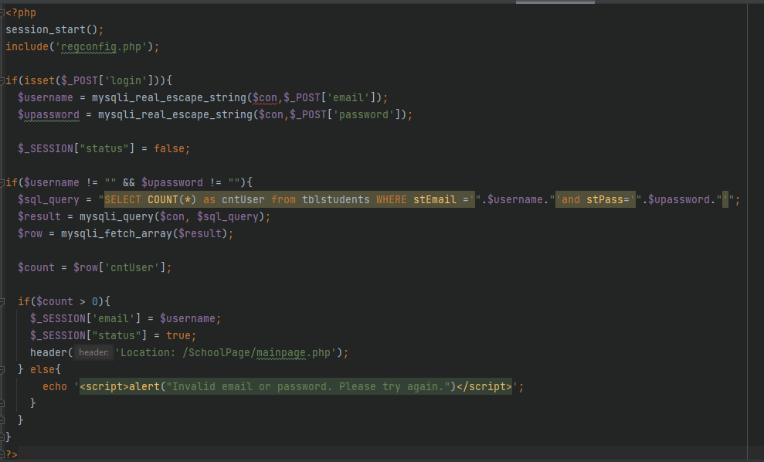
Login PHP Code
Notes:
Once the student clicks the button to login, a username and password variable are setup to hold the connection and the information from the email and password fields on the page’s form. The code then checks to make sure the email and password fields are not blank. Once the code verifies that there is text in the email and password fields it creates a SQL statement to count how many rows are found in the user table where the email and password match the information provided by the user. If there is a match in the database, then the session is initiated, and the user is redirected to the main portal page. If there is no match the user receives an error message. Logging into the student portal provides access to other pages, such as the profile page and catalog. It is important to note that the session variable is vital to the student portal. It allows us to capture and hold the information provided by the user for verification, querying, and permissions purposes.

Slide 10
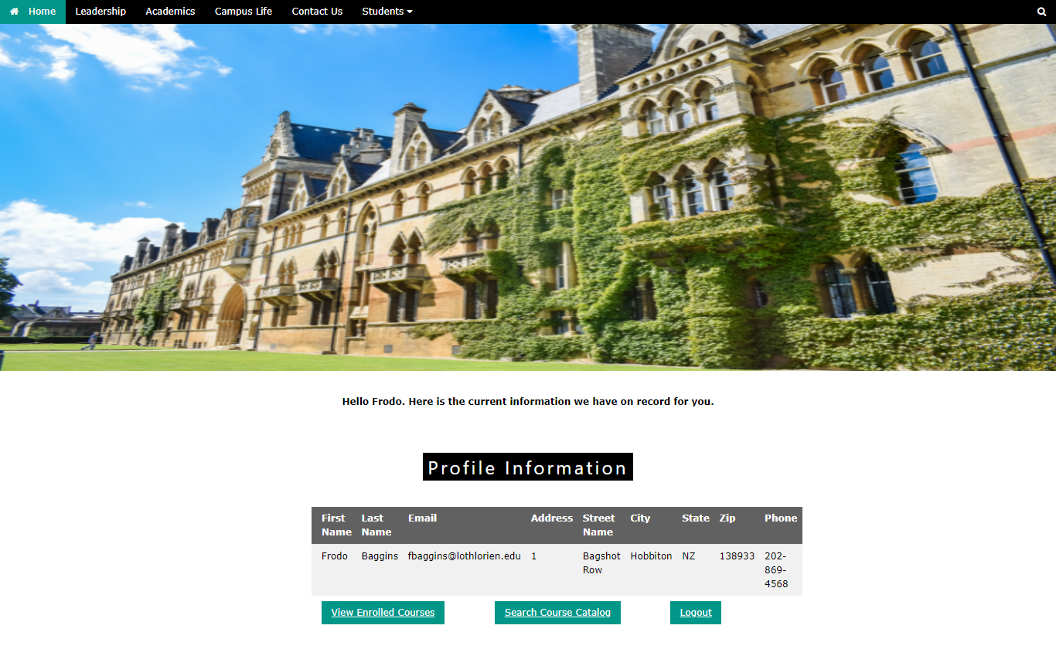
Login example
Notes:
Here we can see that Mr. Frodo has entered his email and password and successfully logged into the student portal. Here he is presented with his profile information that was provided during registration. He also has the option to view his current courses, search the course catalog, or logout of the system.

Slide 11
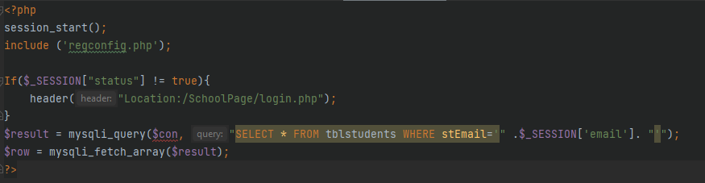
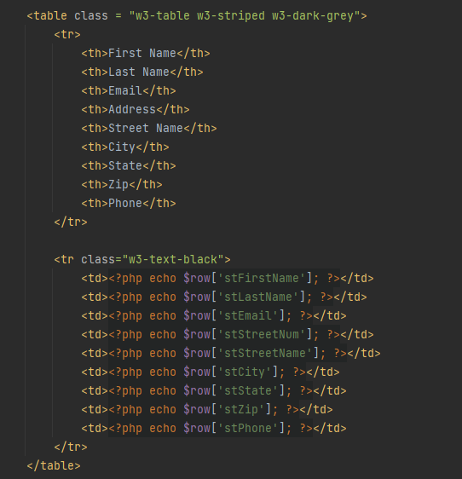
profile PHP
Notes:
The PHP code for the profile page first checks the session status to determine if the user is truly logged into the portal. If the user is not logged in due to the session ending, then they will be redirected to the login page. If the user is logged in, then a result variable is created for the MySQL query. The select query selects all data from the tblStudents table where the login email matches the email in the database. The row variable fetches all rows from the table where there is a match and stores them as an array. The student profile information table on the page then uses the row variable to pull each column from the array. Now let’s take a look at Mr. Frodo’s current courses

Slide 12
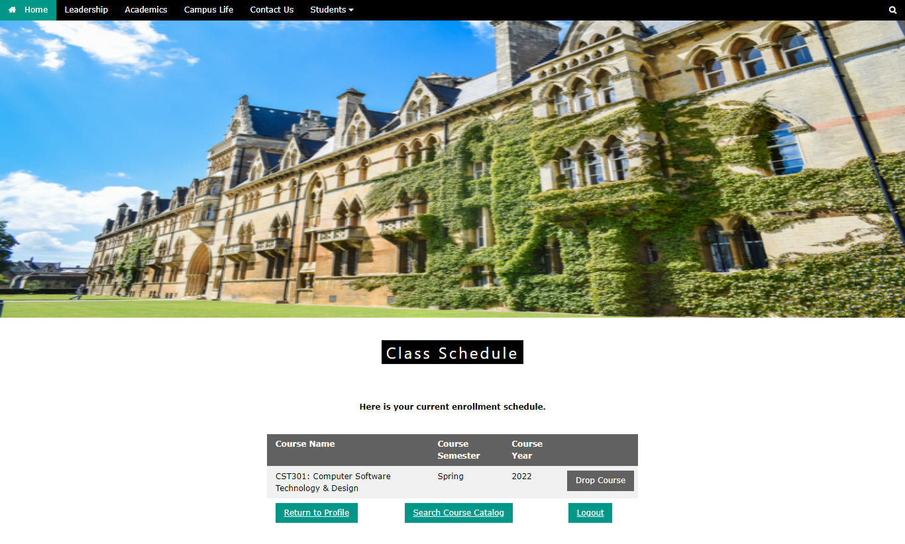
View Schedule example
Notes:
Here we can see that Mr. Frodo has registered for one course. If he so chooses, he can click on the drop course button to be removed from this course, which in turn removes him from the database. He can also click the button to return to his student profile or search the course catalog to enroll in additional courses. Let’s take a look at the catalog now.

Slide 13
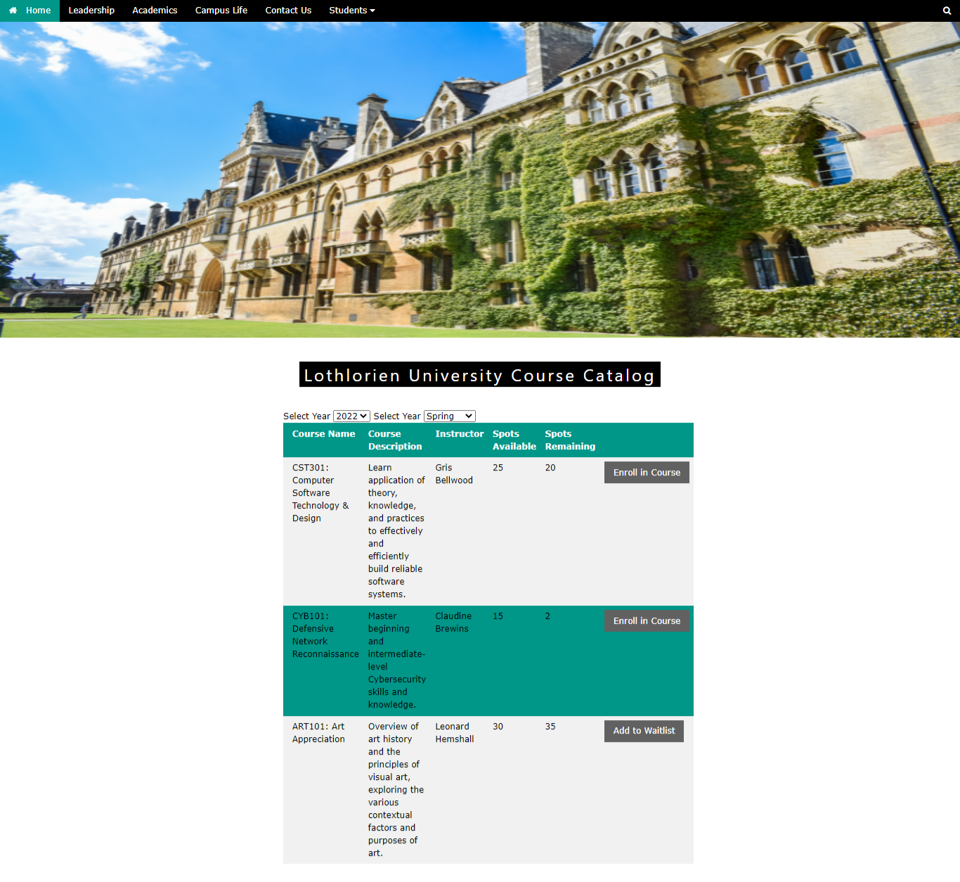

View Catalog example
Notes:
In the course catalog, Mr. Frodo can filter and view additional courses that are available. If a class is full, he can be added to the waitlist. If a class is available, he can enroll in the course and in doing so he will be given the option to drop the course from the catalog. In our example we can see that Mr. Frodo enrolled in the Defensive Network Reconnaissance course. Let’s see what selecting these courses looks like on his course view page.

Slide 14
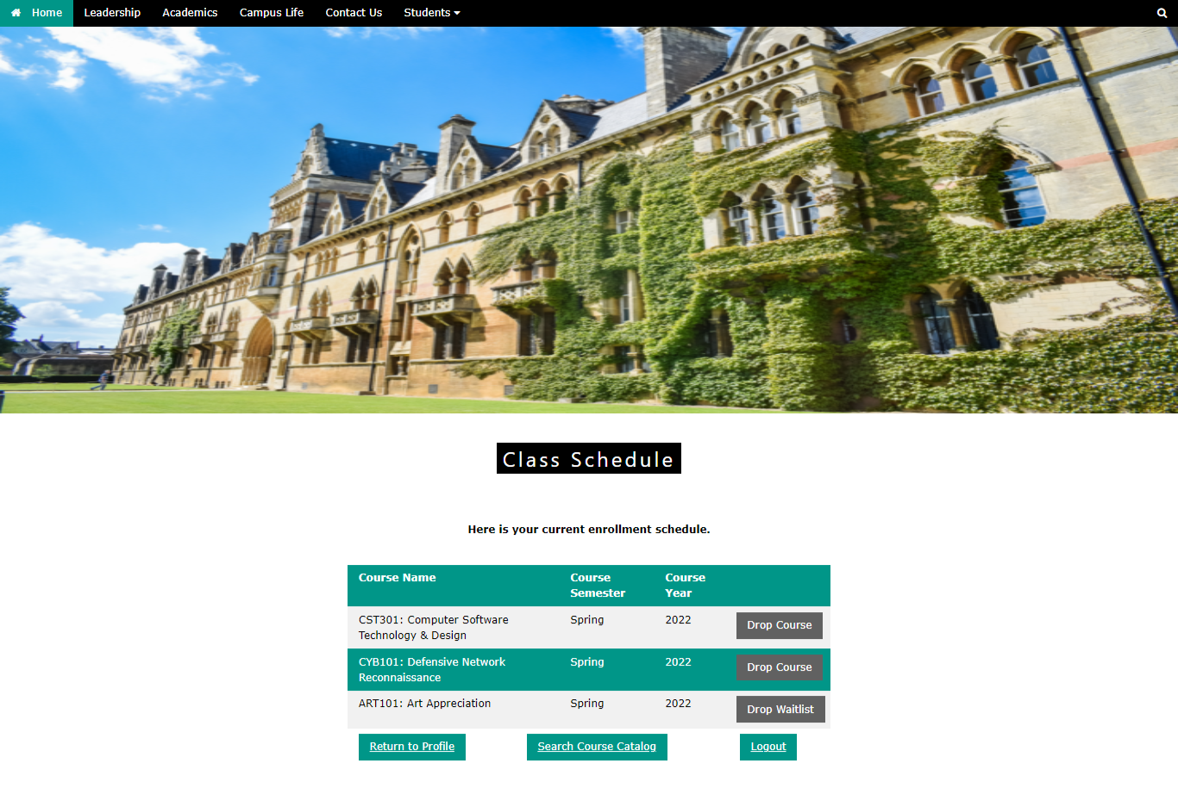
View Course Updates example
Notes:
Now if we look at the class schedule, we can see that Mr. Frodo has a new course and one that he is currently on the waitlist for.

Slide 15
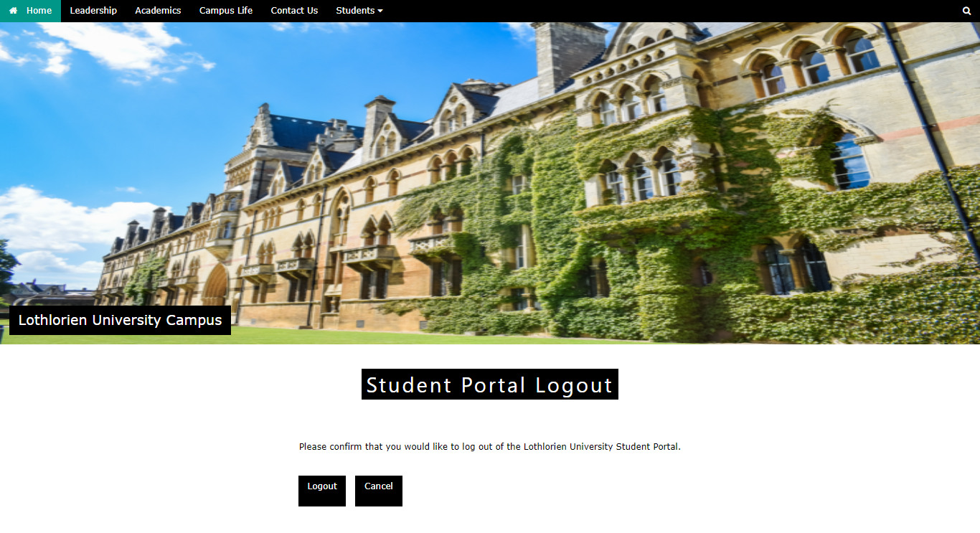
Logout page
Verifies that user wants to logout of system
PHP code:
Ends the session
Directs user back to main page
Notes:
The logout page allows the student to logout of their session. The website asks the user to verify that they would like to logout of the portal. Once they verify that they want to logout the PHP code ends the session and redirects the user back to the main page. If they click cancel they are redirected back to their profile page.

Slide 16
closing
User registration
Portal Login
Enrollment Functionality
More to come….
Notes:
In closing the Lothlorien Student Portal allows students the ability to register for access, login to the portal, and enroll in courses. All the information is housed in the university database and can be used for tracking, security, and reporting. Over time Lothlorien University will continue to build out their student portal by adding additional forms, authentication, and functionality.

Slide 17
THANK YOU
Notes:
Thank you for your time.

